Slide 1


DMW Implementation
Michail Gongolidis

Slide 2
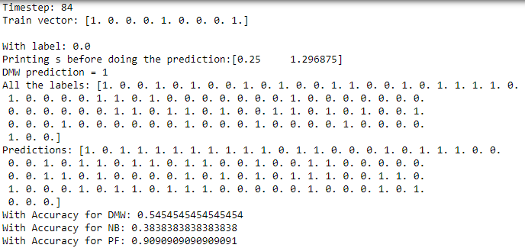
Over one iteration

Slide 3
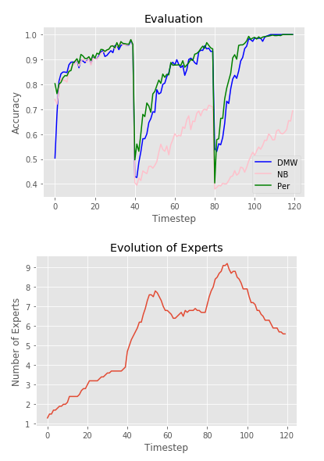
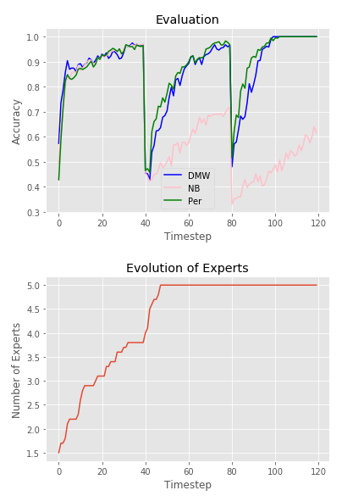
Metrics for Stagger
Without limits
With Limits

Slide 4
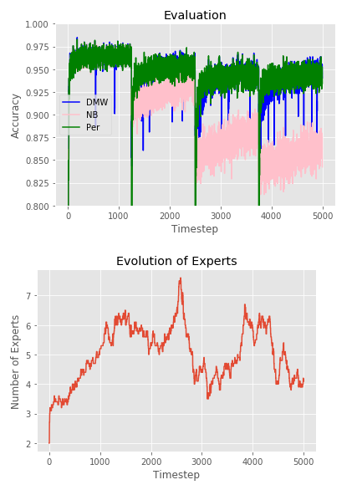
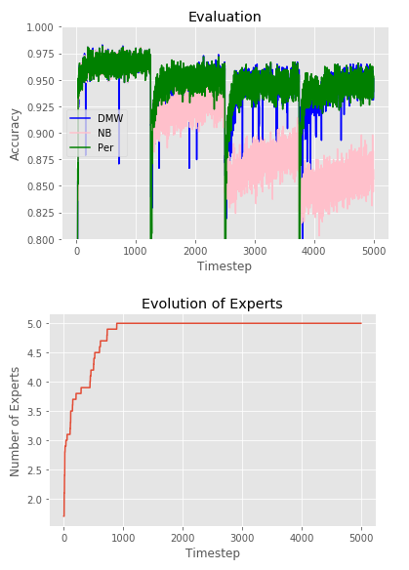
Metrics for Sea
Without limits
With Limits

Slide 5
Thank you !

